Slide 1
Problem Statement & Solution
Problem Statement
Ensure code coverage through Functional Automation Testing to ensure critical Lines of codes are traversed/validated and provide higher confidence to stakeholders and improve quality of the product
Solution
Increase Unit Level Testing and measure the code coverage through Static code analysis tool (Sonarqube) and reflect converge in functional test results by creating code level traceability and mapping to functional test cases

Slide 2




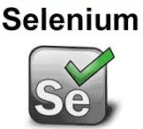


Proposed Solution
Improve collaboration between Dev & QA
Unit Testing for all applications
Implement Static code analysis tool and measure code coverage
Infrastructure setup
Traceability Matrix @ code level
Shared responsibilities
Automation Engineer – Upskilled
Environment Setup
Support from Dev team
Accelerators for Class/Fun vs Test Case mapping
Enablers
Enablers
Development
Functional Automation
N-unit
SonarQube
(Plugins)
QTP/UFT
Code Level Mapping and Define Rules
Selenium
Junit/TestNG
End to End Traceability
Custom Tools
Z-unit
Code Coverage – 90% BUG free code
Automated Static code analysis
Unit Testing
Shift left
QA – QE Transformation
Improve Quality and early defect Deduction
Mapping of Functional automated scripts with code groping
Generate Results and produce mapping results
Benefits

Slide 3
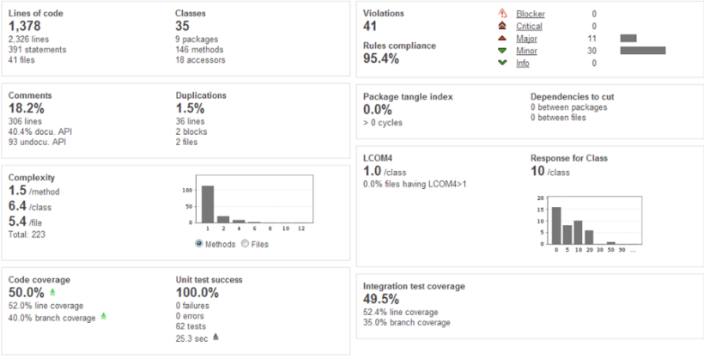
Static Code Analysis – Sonarqube Dashboard
Static Code Analyses
Validate Coding Standards
Security vulnerabilities
Duplicate code
Code Complexity
Documentation and comments
Whether the code has unit tests
Code Coverage
Whether the code follows architecture principles

Slide 4
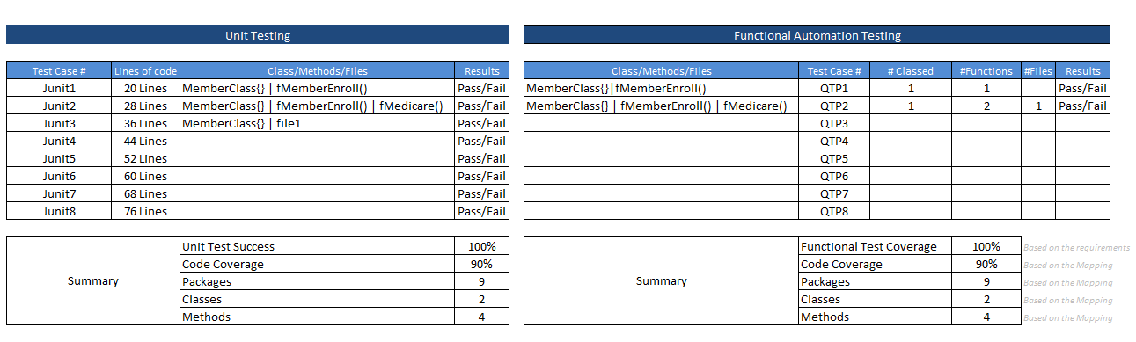
Unit |Functional Test Case - Reference Mapping

Slide 5
Roadmap
Q1
Q2
Q3
Q3
Q4
Q1
2017
2017
2017
2017
2017
2018
Action Plan
Initiate – Analysis
POC/PILOT
Phase I – Implementation – Java
Sonarqube – Centralized Process
Unit Testing – Centralized Process
Functional Testing
Phase II– Implementation – Mainframe
Phase III – Implementation – Cross Technologies
TBU
TBU
Benefits

